Slide 1
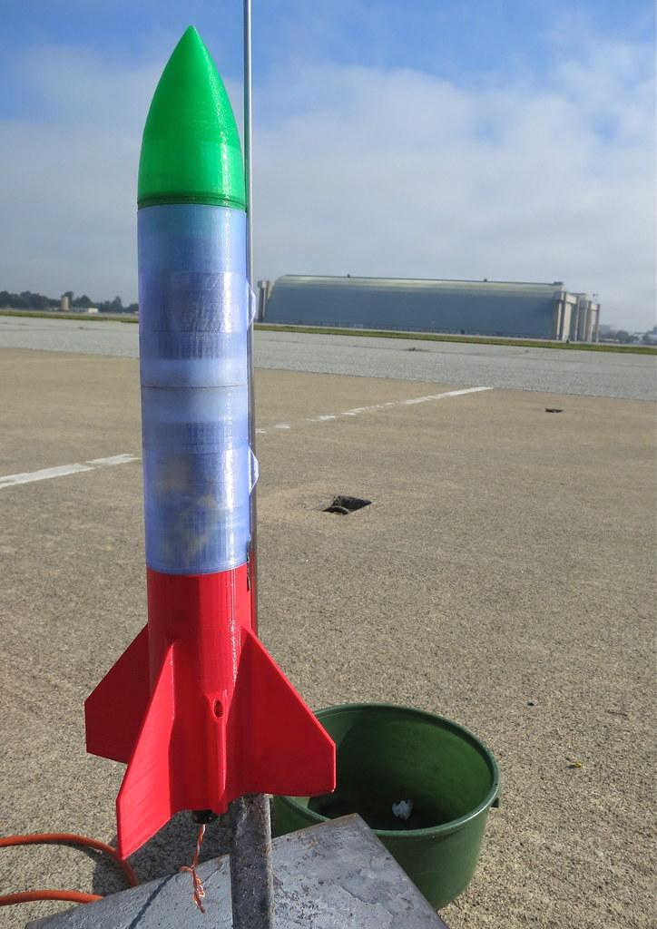
PROJECT KJB

Slide 2
Introduction to Rocket Design
Project Overview
This project focuses on innovative rocket designs and launching methods.
Key Components of the Water Rocket
Rocket : Round shape head with three fins and custom made garden hose nozzle that is fitted to a bottle
Launch Pad: contains a garden hose connector with a inbuild releasing mechanism for the bottle.
Activation/Releasing Method: Introduction of a creative launch activation method to enhance the launching experience.

Slide 3
List of components used in the project
Bicycle carrier(as the launch pas supporter)
1.5ft*1.5ft corrugated plastic sheet(as the launch pad)
1m of rubber tube(as a connector to the air pump and the hose connector)
A hose connector and a garden nozzle.
Zip ties
XIXO bottle(as the rocket)
A tennis Ball
Super glue
A brake cable and a brake handle
Duct tape
Hose clips
PVC tube

Slide 4
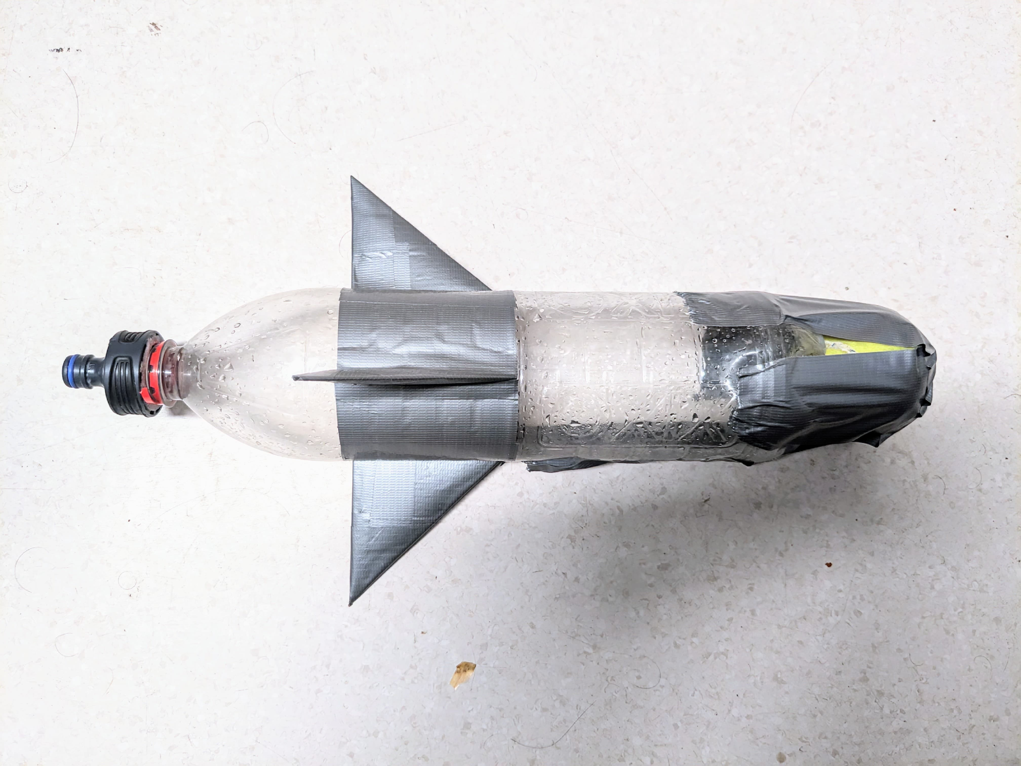
Rocket
Rocket head
Consist a tennis ball on the top of the rocket to support the shape and to make the rocket stable during the flight.
Uses duct tape to fix it with the bottle.

Slide 5
Technical drawing of the bottle

Slide 6
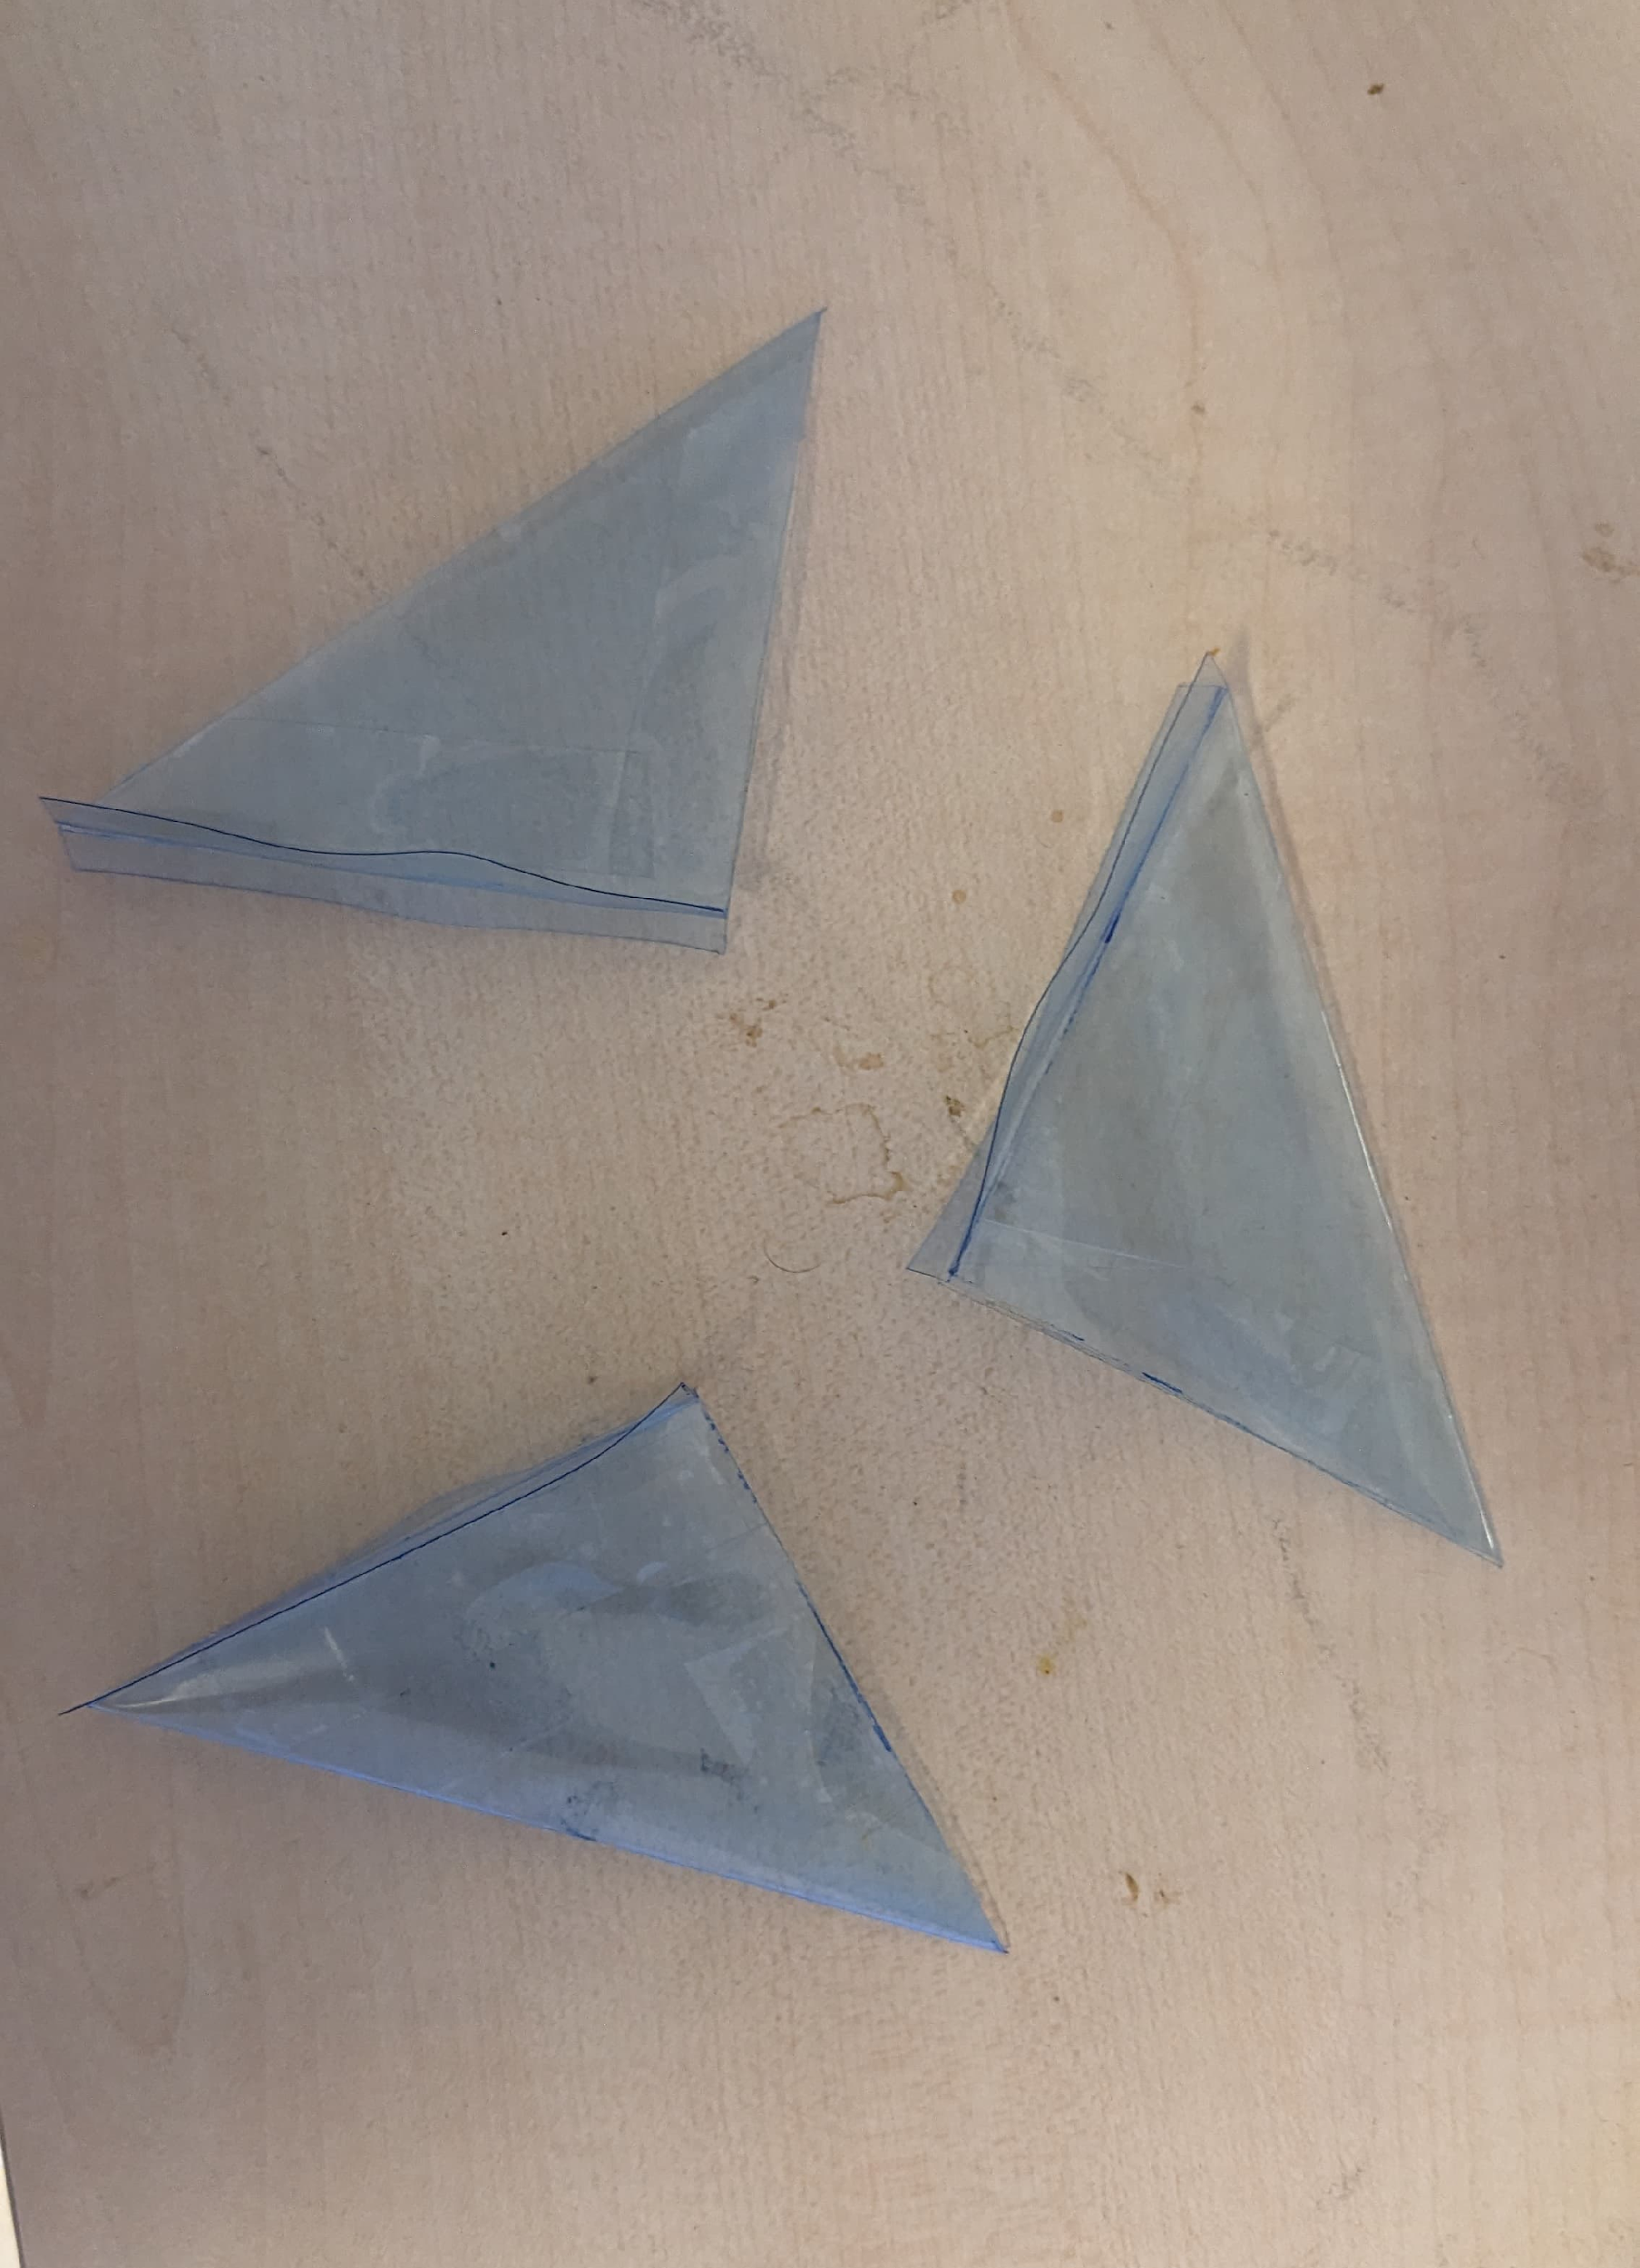
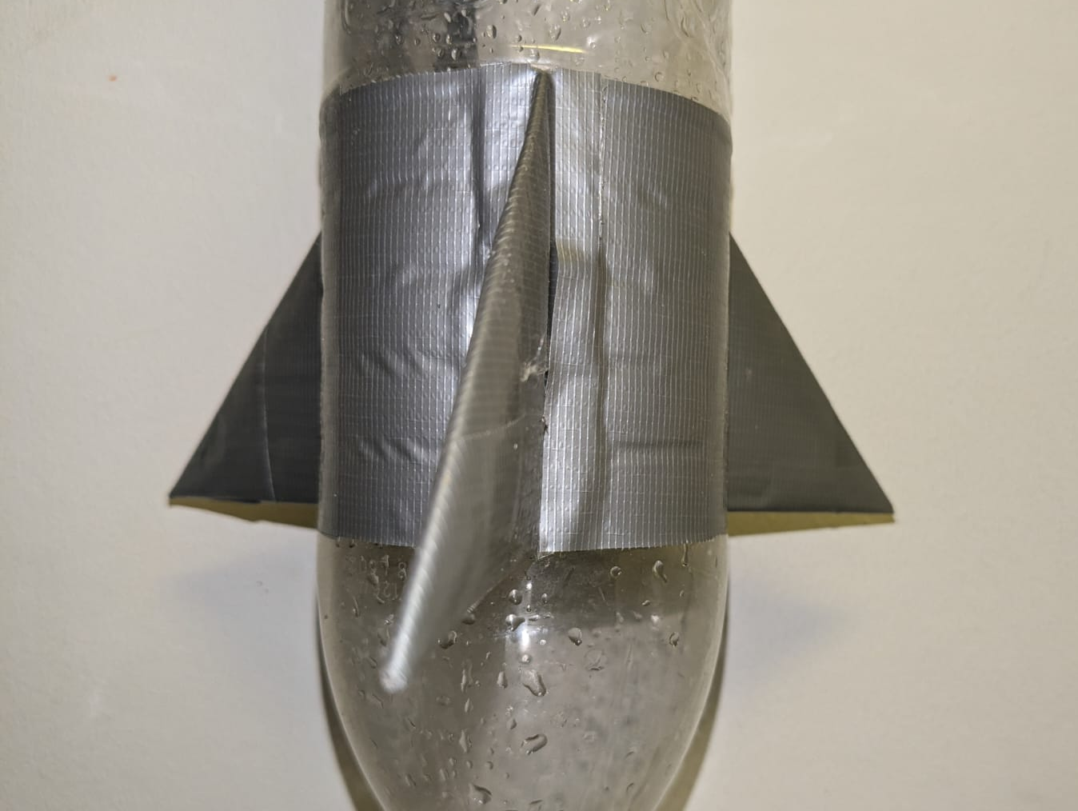
Fins
Use of three triangular fins in the bottom of the bottle to enhance the stability of the rocket by creating a drag at the lower part of the bottle.
Made of bottle plastic material and attach to the bottle using the duct tapes.

Slide 7
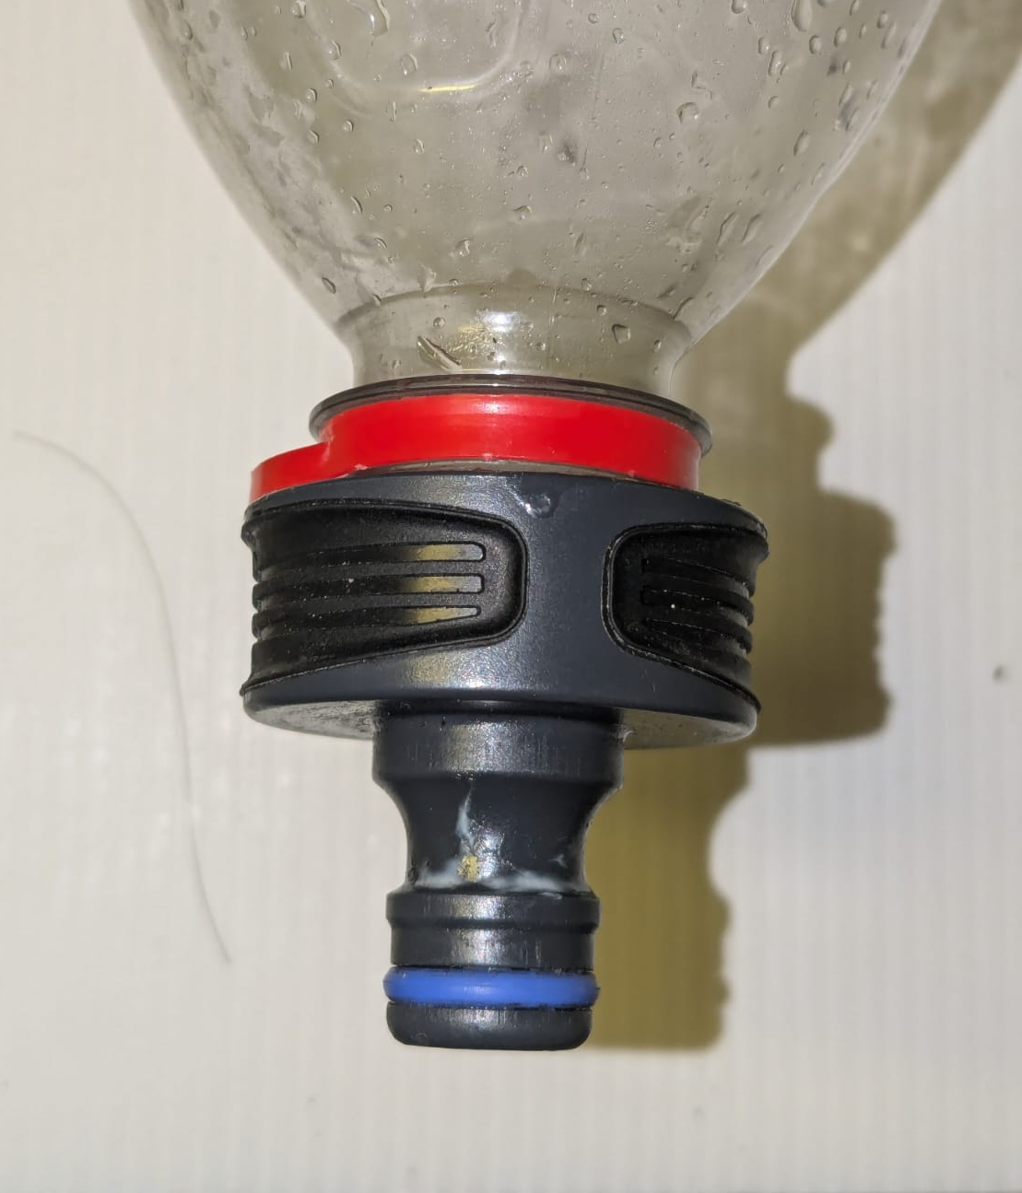
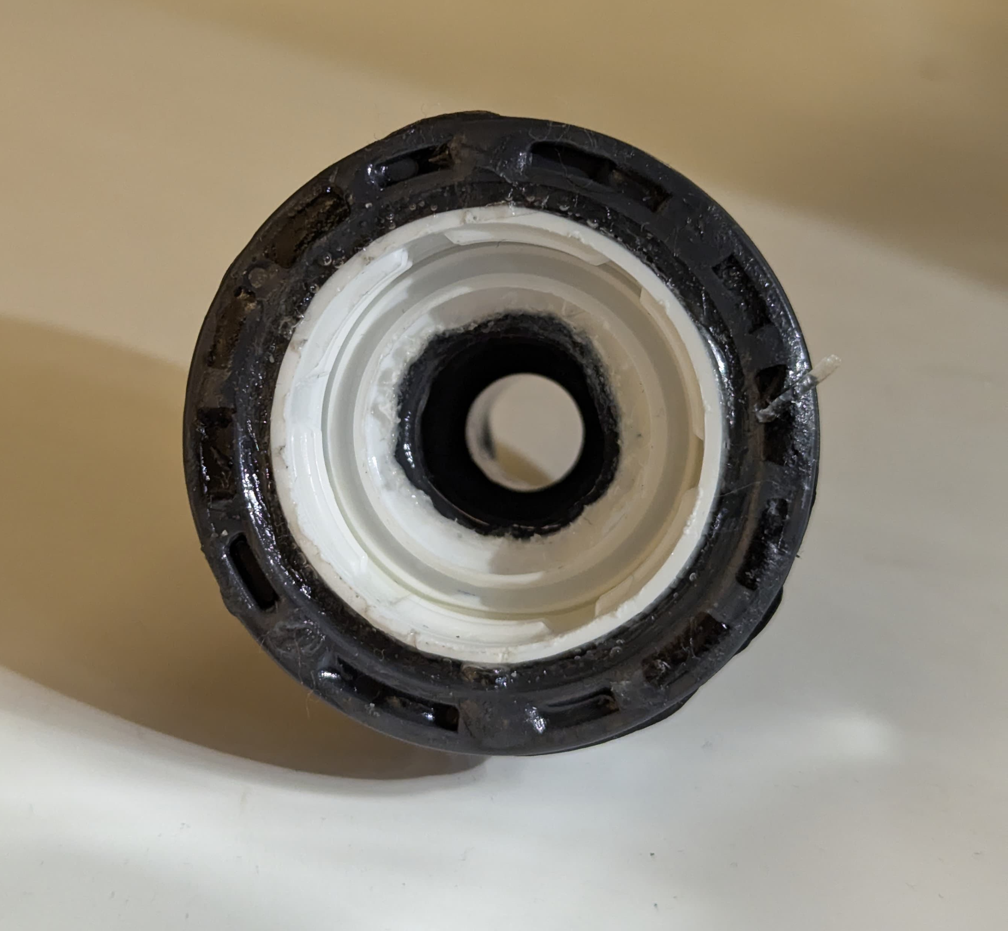
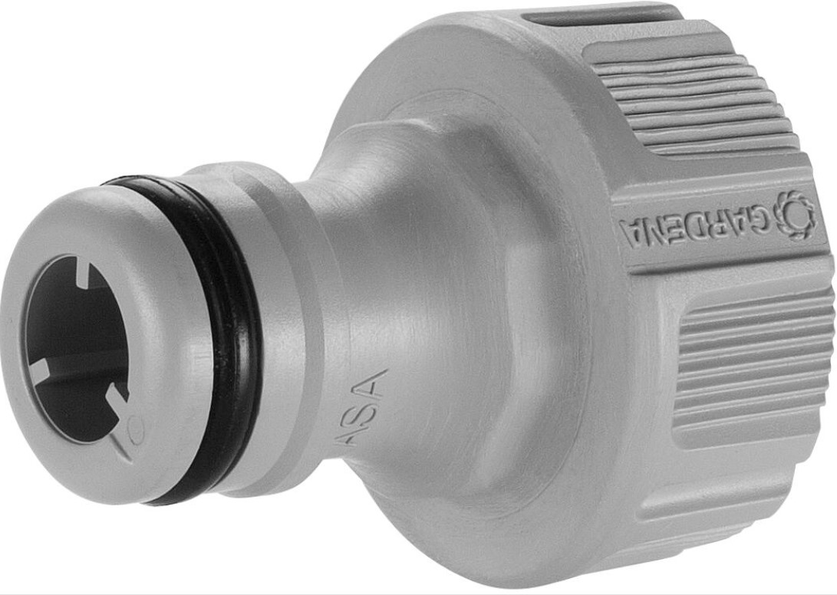
Rocket nozzle/ Garden hose nozzle
Pasted bottle lid to the garden nozzle with the use of glue to create a custom made nozzle.
Small nozzle gives more time to create the thrust with the water instead of emptying the bottle in a very short period of time.
Use of bottle lid with the nozzle makes it easier to connect and prevent the water leakage.
Had to use some grease in the nozzle to reduce the friction when releasing from the horse connector.
Attached nozzle to the bottle
Nozzle connected to the bottle lid
Garden nozzle

Slide 8
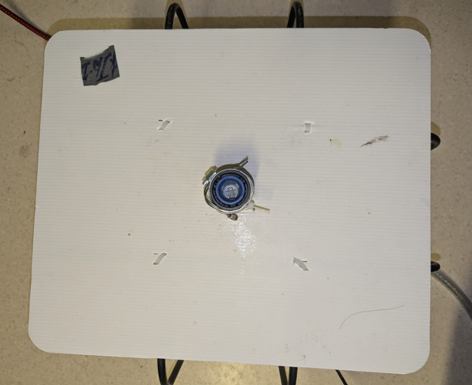
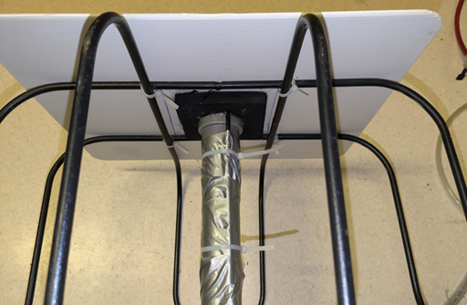
Launch pad
A corrugated plastic sheet fixed on to a bicycle carrier is used as a launch pad.
Fixing the bicycle carrier to the plastic plate makes more stable and support the launch with the stability.
Zip ties were used to connect them together.
A rubber plate fixed under the plastic sheet reinforced the horse connector and supported the weight.
The PVC tube acted as a supporter to keep the rubber tube and the brake cable stable and fixed without any loose.

Slide 9
Technical drawing of the launching pad

Slide 10
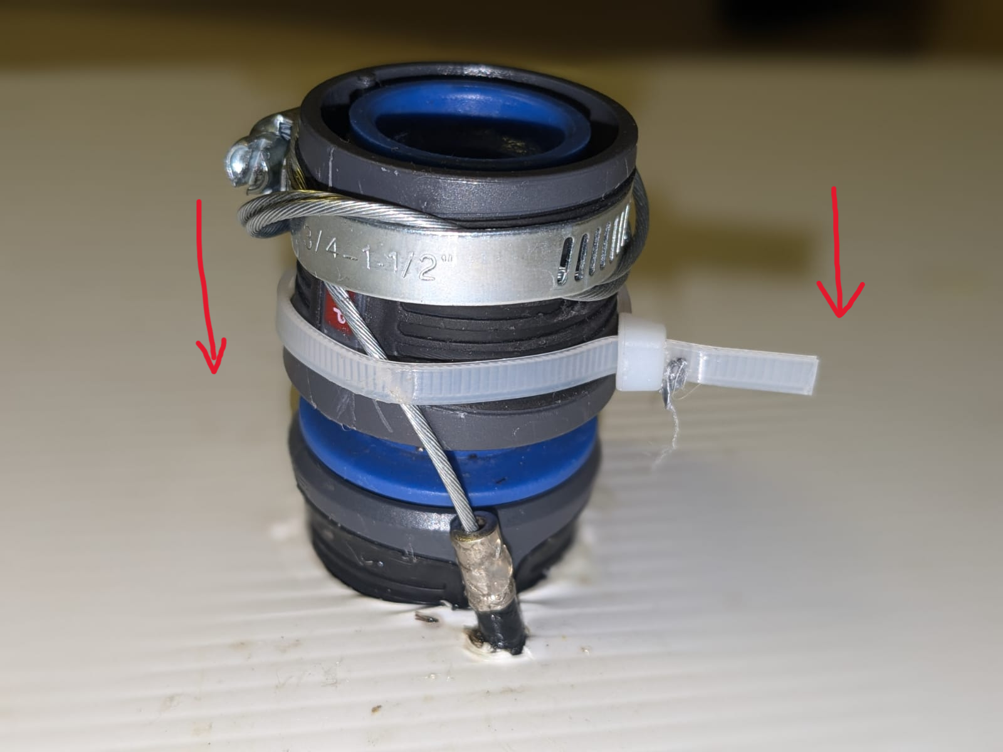
Releasing mechanism
The hose connector
Design: A garden hose connector with a inbuild releasing mechanism was used to connect the bottle with the nozzle.
Air flowing pipe is connected to the other end of the hose connector which prevent any water leakages.
A brake cable tied to the hose connector triggers the release of the bottle. It moves in the direction as it shown by the red arrows
A hose clip and a zip tie were used to fix the break cable with the hose connector.

Slide 11
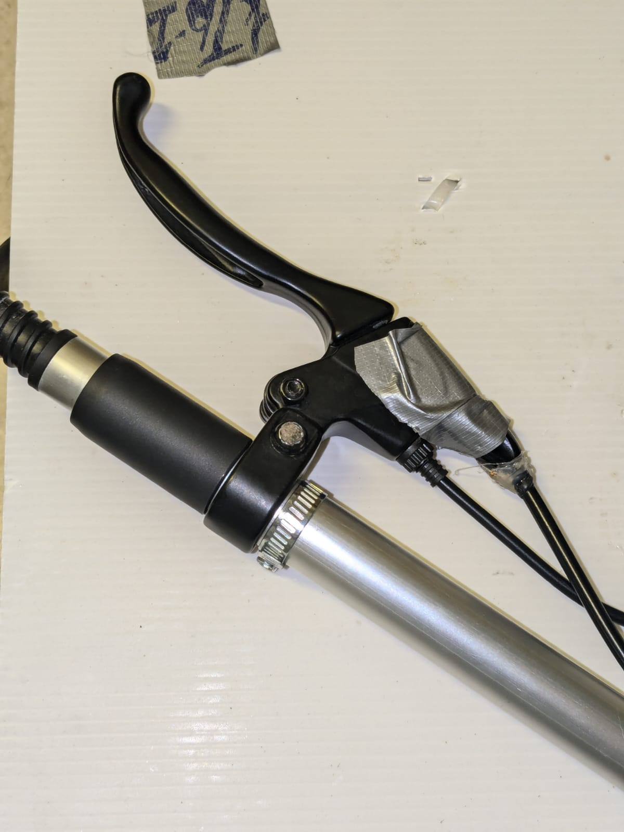
2. The brake Handle
The other end of the brake cable is connected to the brake handle enabling a easier launch.
The brake handle was fixed to a broom handle.
The cable

Slide 12
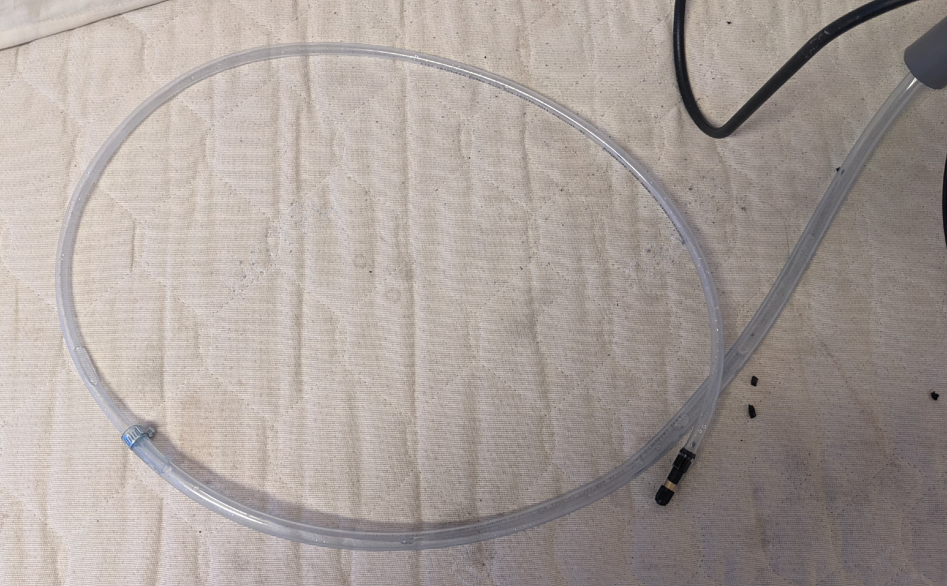
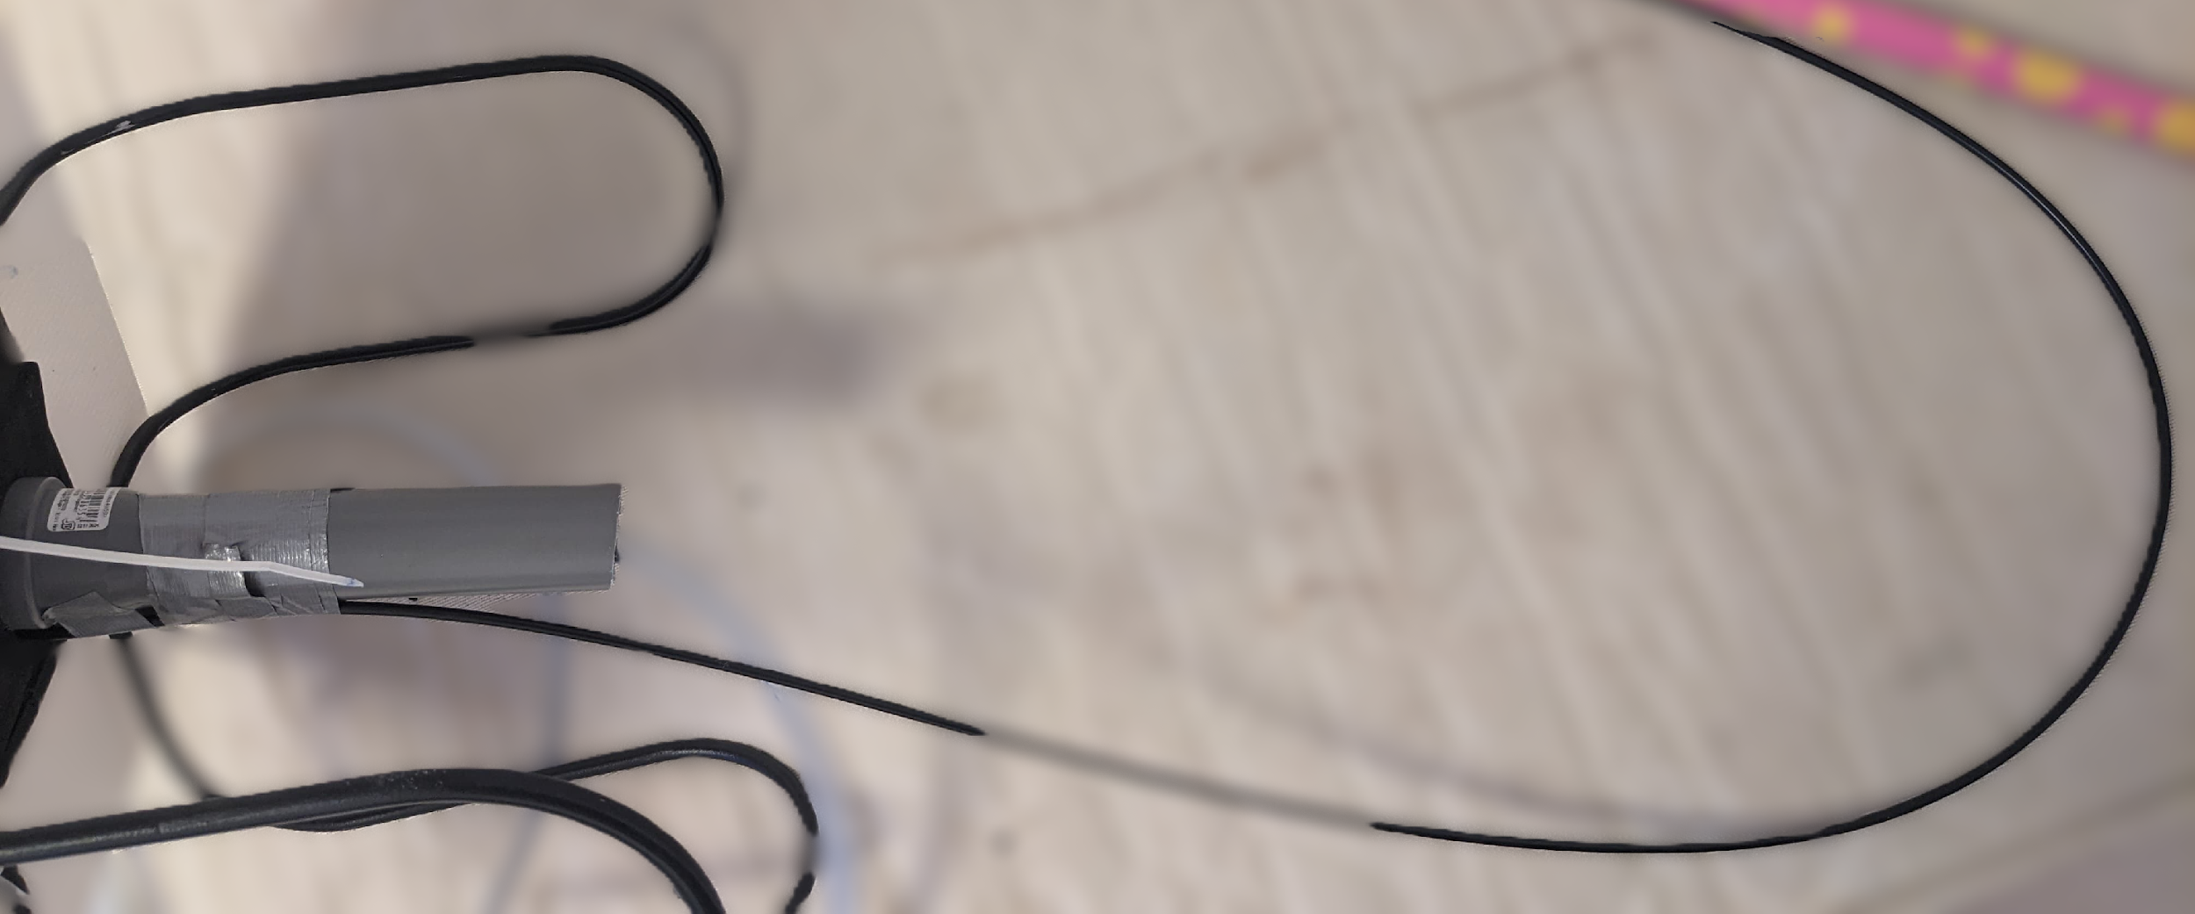
Safety mechanisms
Using a silicon tube to pump the air into the bottle from the air pump reduces the possible accidents that can happen when testing.
Use of a lengthy cable to trigger the releasing mechanism also reduces the accidents that can happen during the releasing of the water rocket.

Slide 13
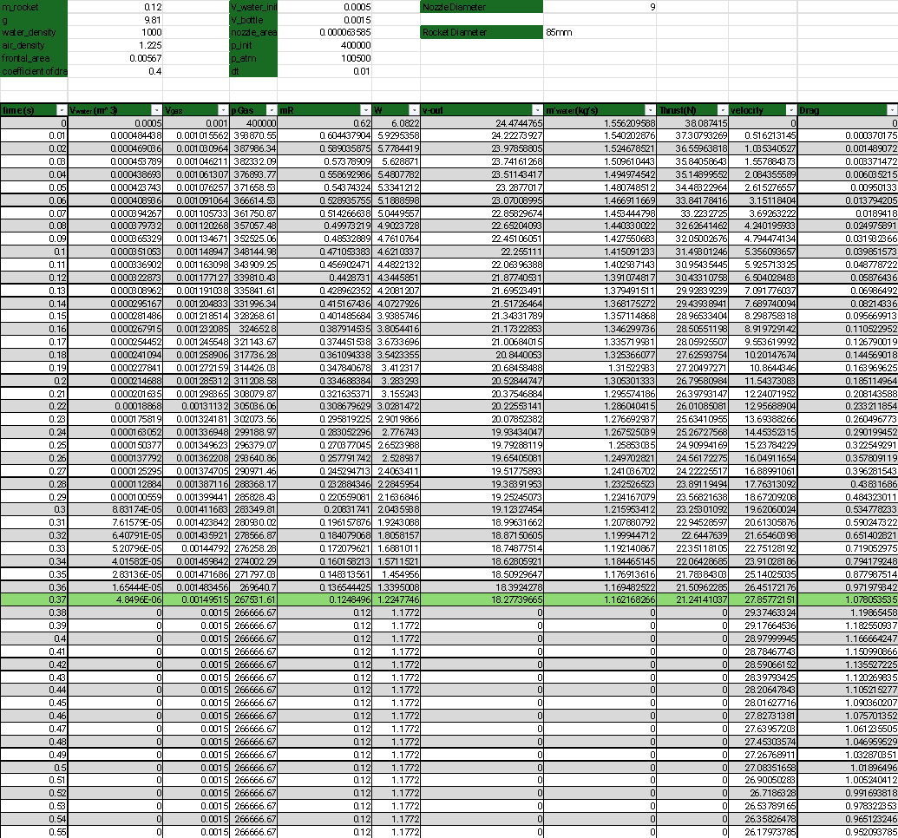
Calculations
Calculations :

Slide 14
Graphs

Slide 15
Thank you for your attention

